Slide 1

Water WX Weather Station
Original from December, 2019 by:
Kristopher Stewart
Melody Grappo
Scylla VanZwol
Ryan Lingg
Updated February 2020 by Grant Barton
Advisor: Erik Fretheim

Slide 2
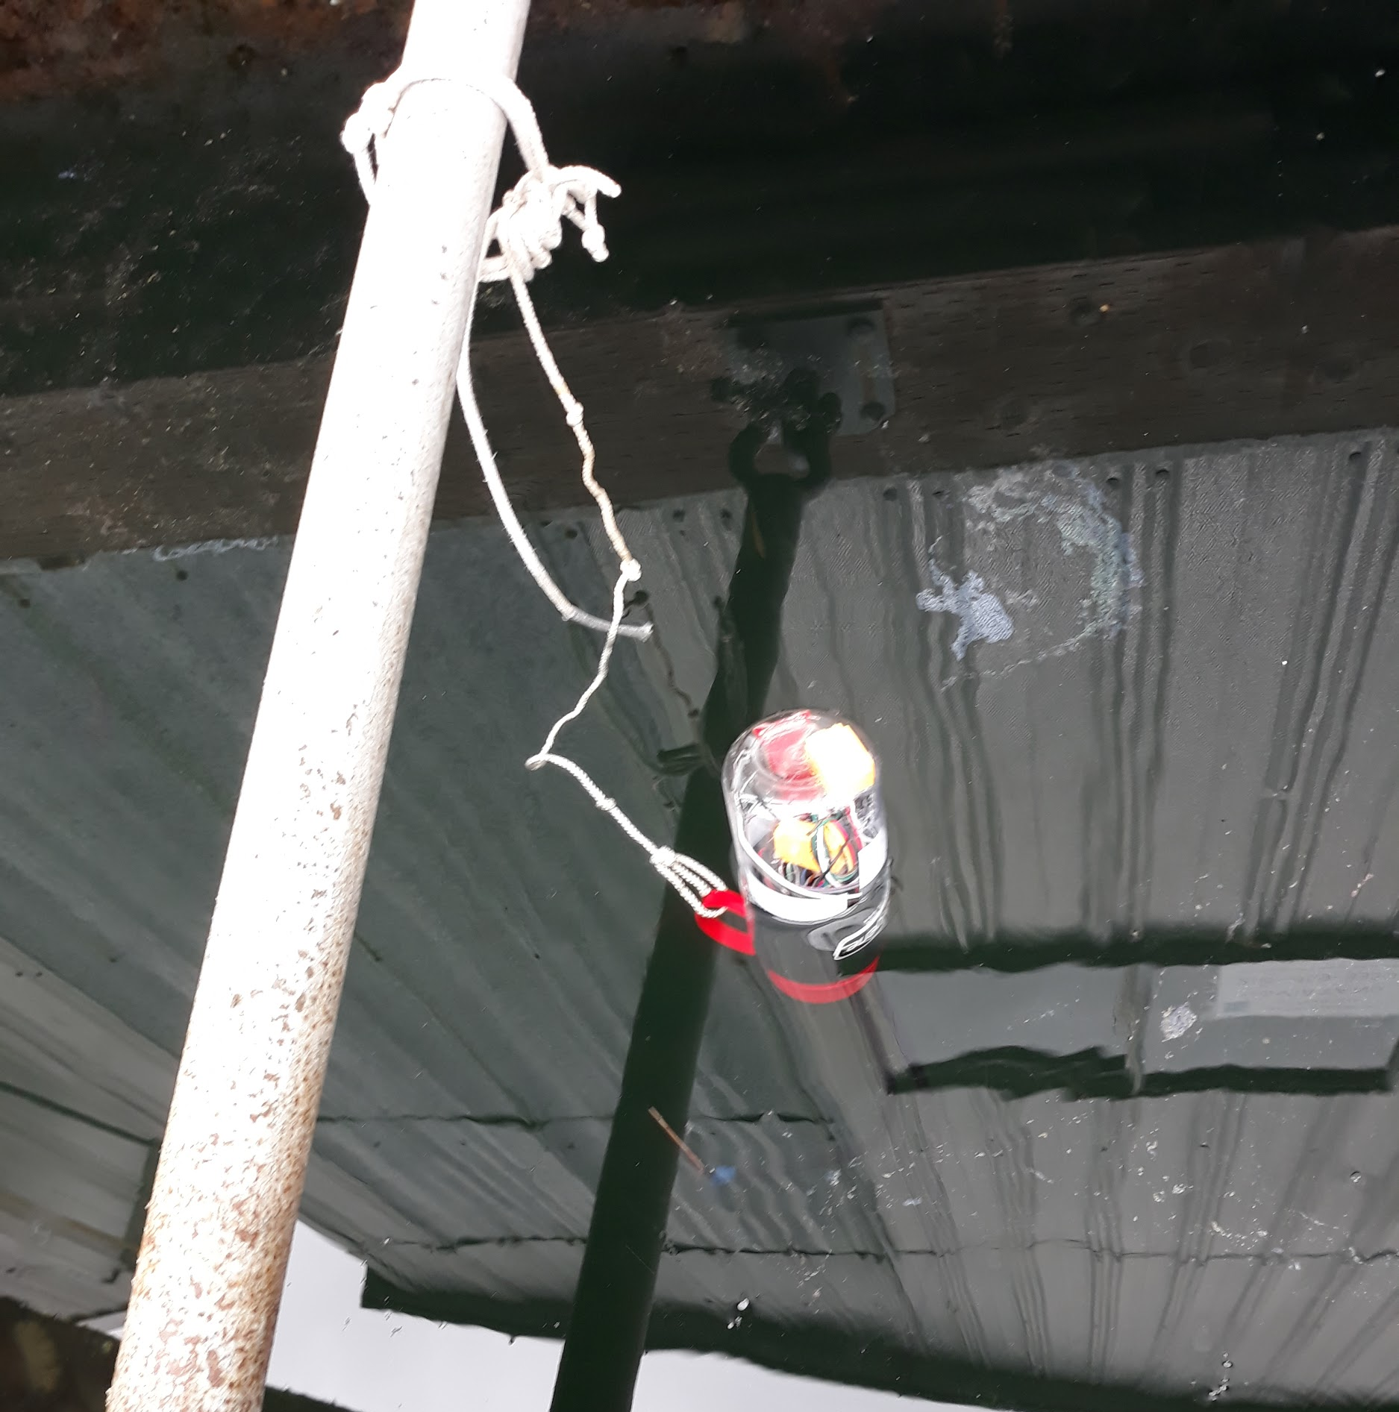
In a nutshell...
A buoy that collects environmental data in the Salish Sea
A mobile app to retrieve data from the buoy and send data to the server
A webserver to store and display the data
Covers a spectrum of comp-sci areas:
Electrical engineering
Embedded systems
Mobile app development
Front-end web and database development

Slide 3
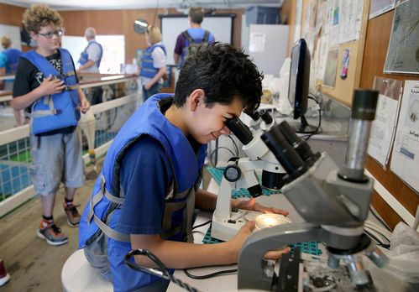
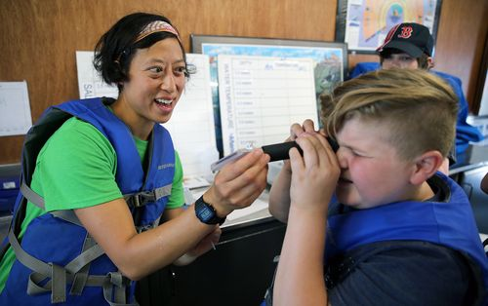

Motivation
For the annual WWU Cybersecurity camp at the SEA Discovery Center in Poulsbo
Demonstrate the intersections of different disciplines
Teach principles of cybersecurity
Collect data from the Salish Sea that other researchers can use
Notes:
https://www.kitsapsun.com/story/news/local/2018/07/28/cybersecurity-free-camp-western-washington-university-poulsbo/846291002/

Slide 4
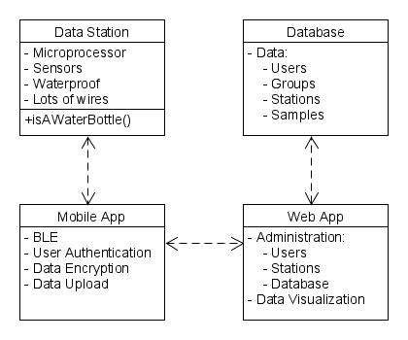


Our approach
Four main components:
Data gathering station
Mobile app for comms with station
Web app for front- and back-end work with data
Database
Server hosted in the WWU Cyber Range located in the Poulsbo campus

Slide 5
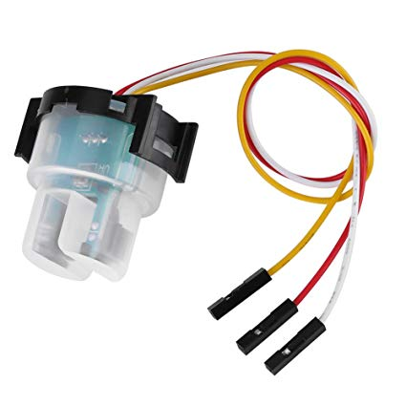
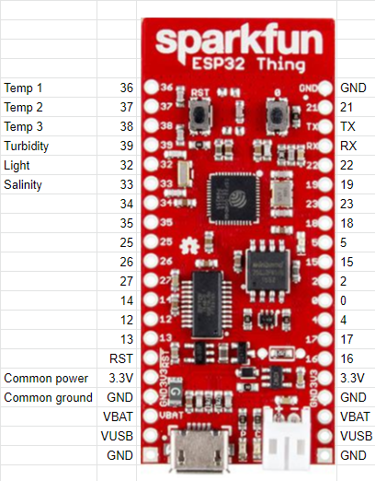
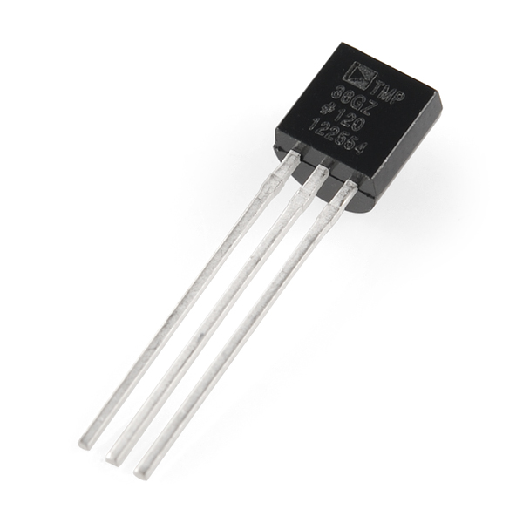
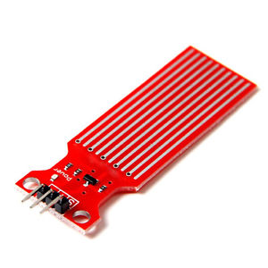
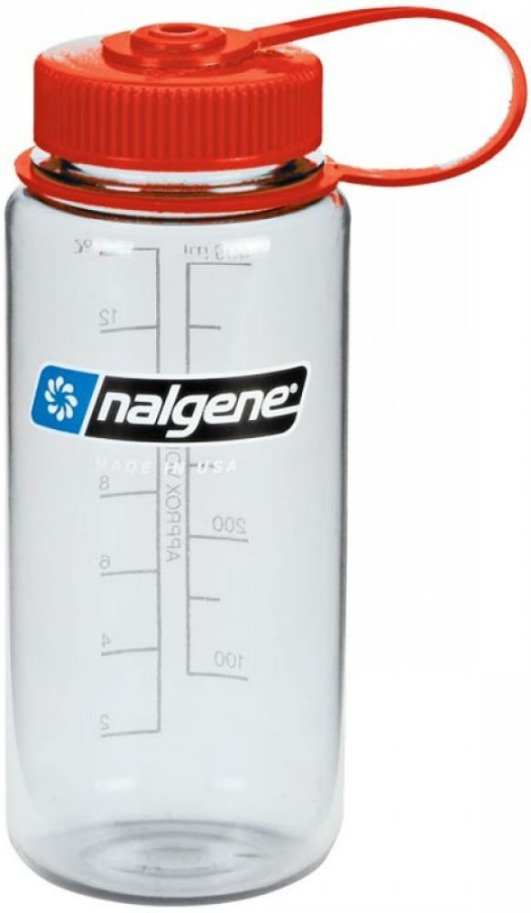
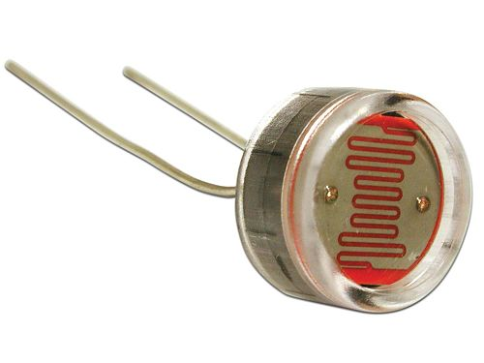
What’s with the water bottle?
Sparkfun ESP32 Thing
Sensors
Temperature
Turbidity
Salinity
Insolation
Nalgene bottle as the buoy
Waterproofing applied via
marine-grade epoxy and resin

Slide 6
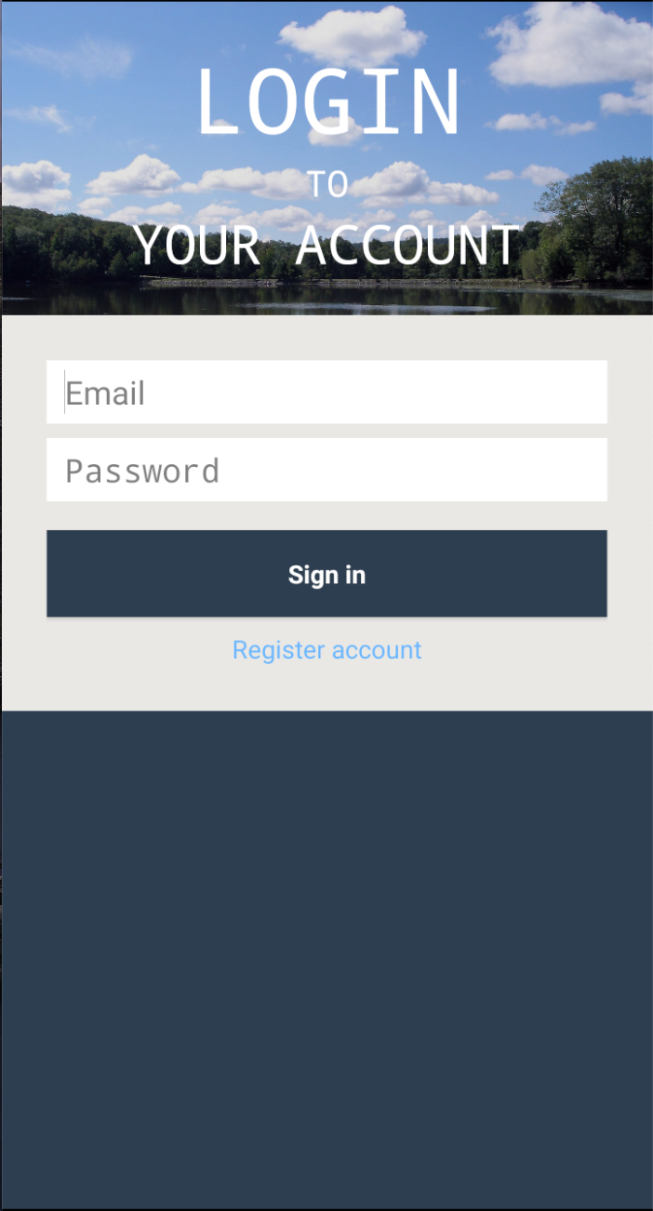
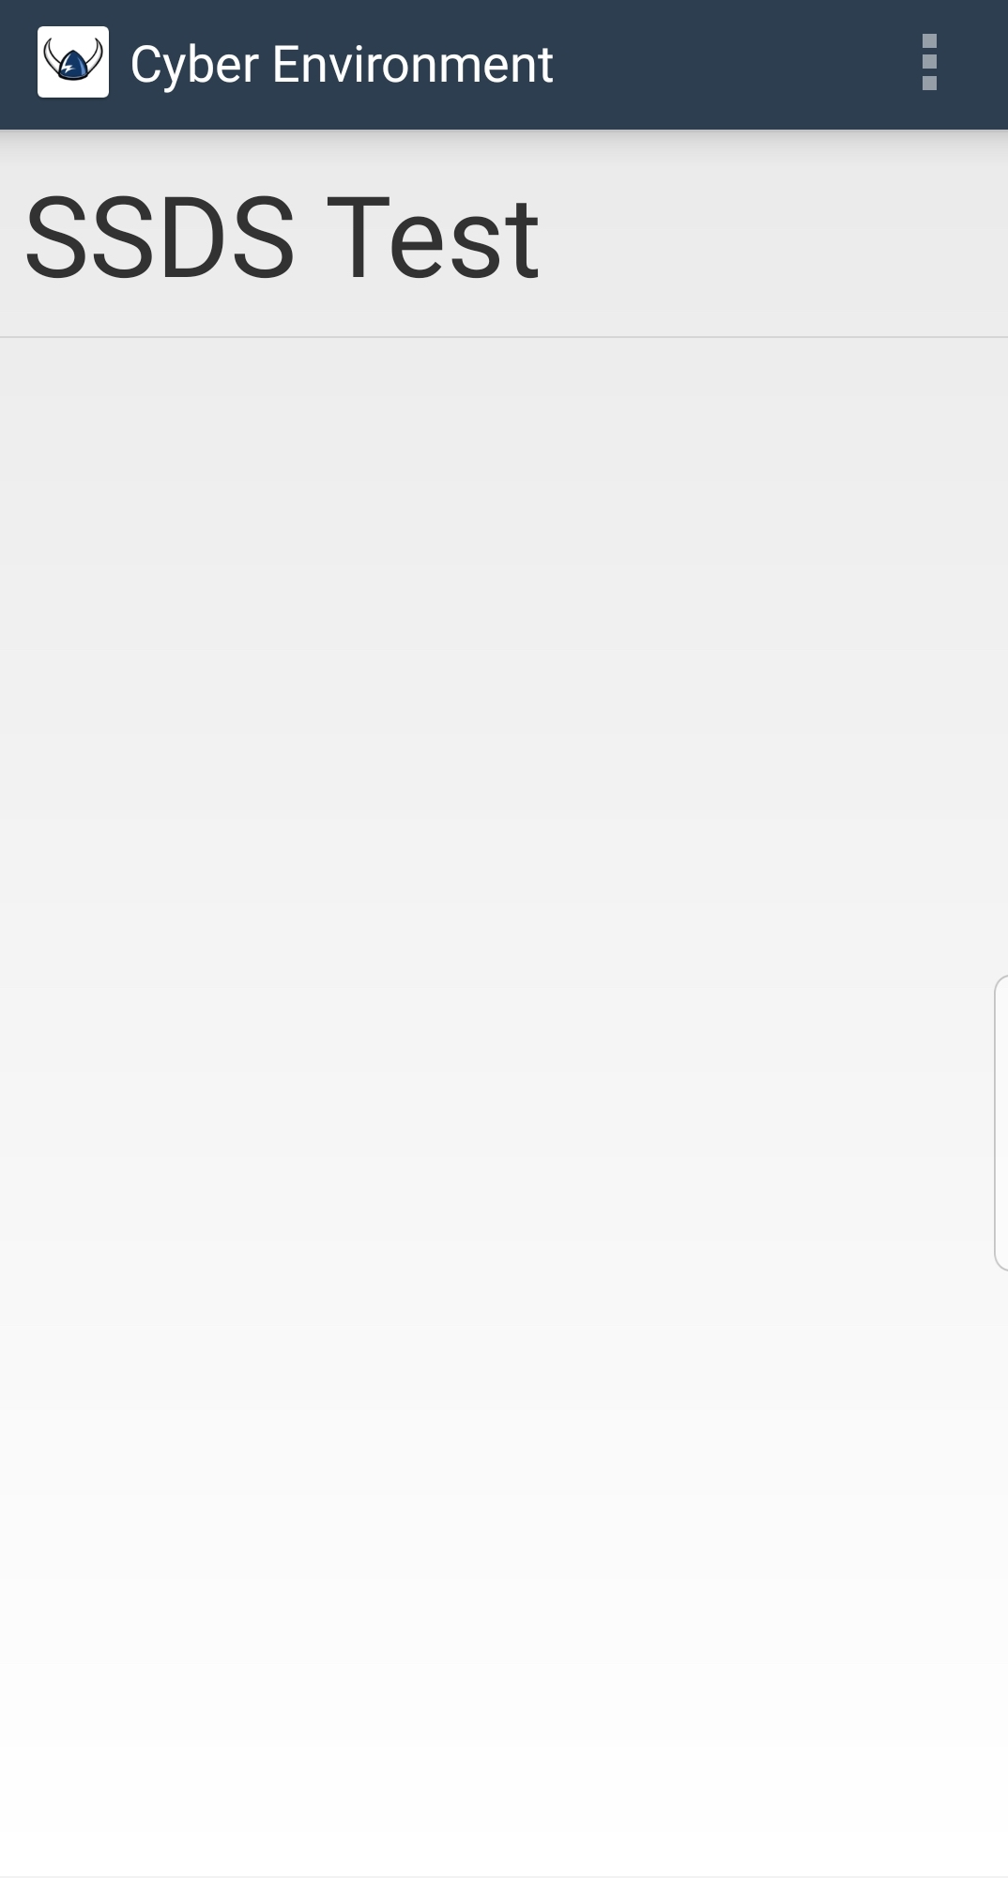
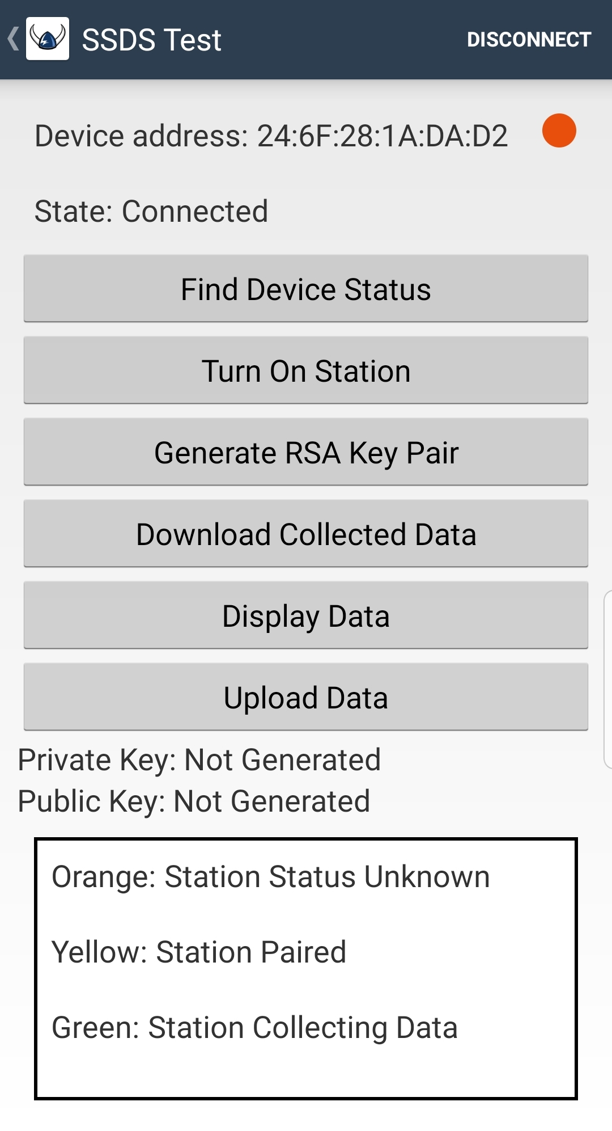
Android Phone App

Slide 7
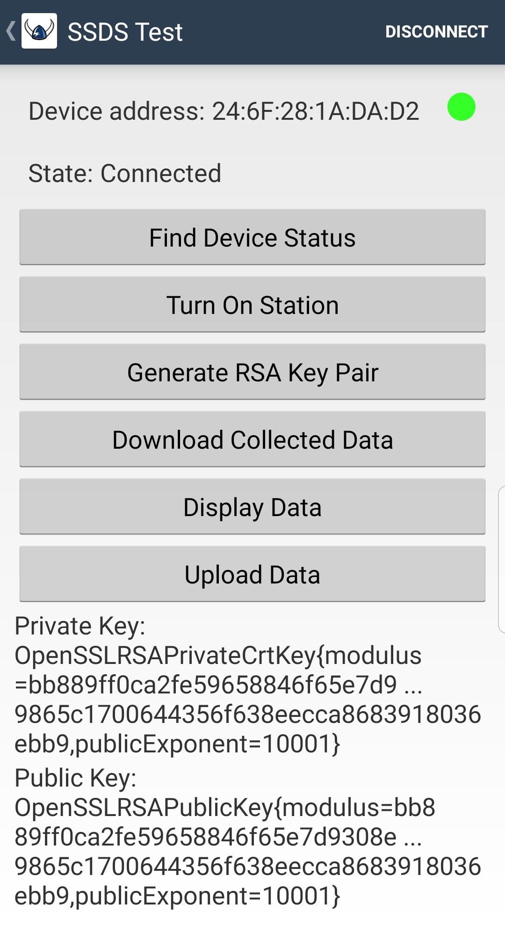
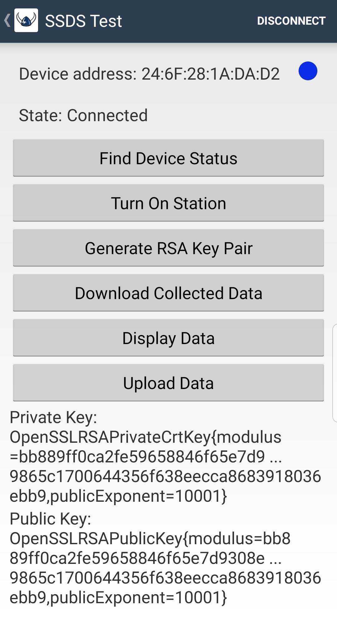
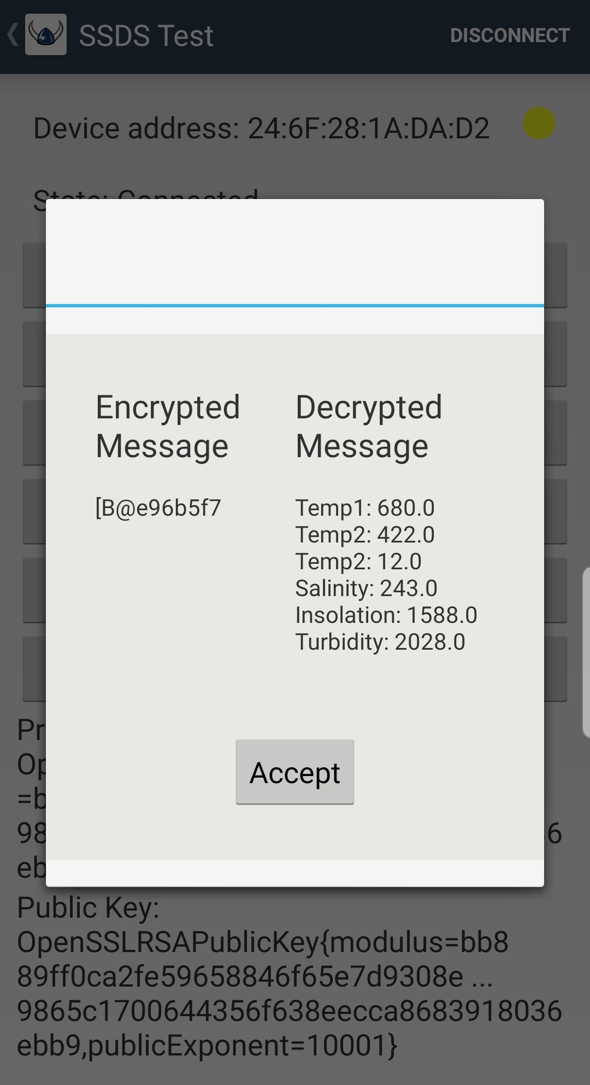
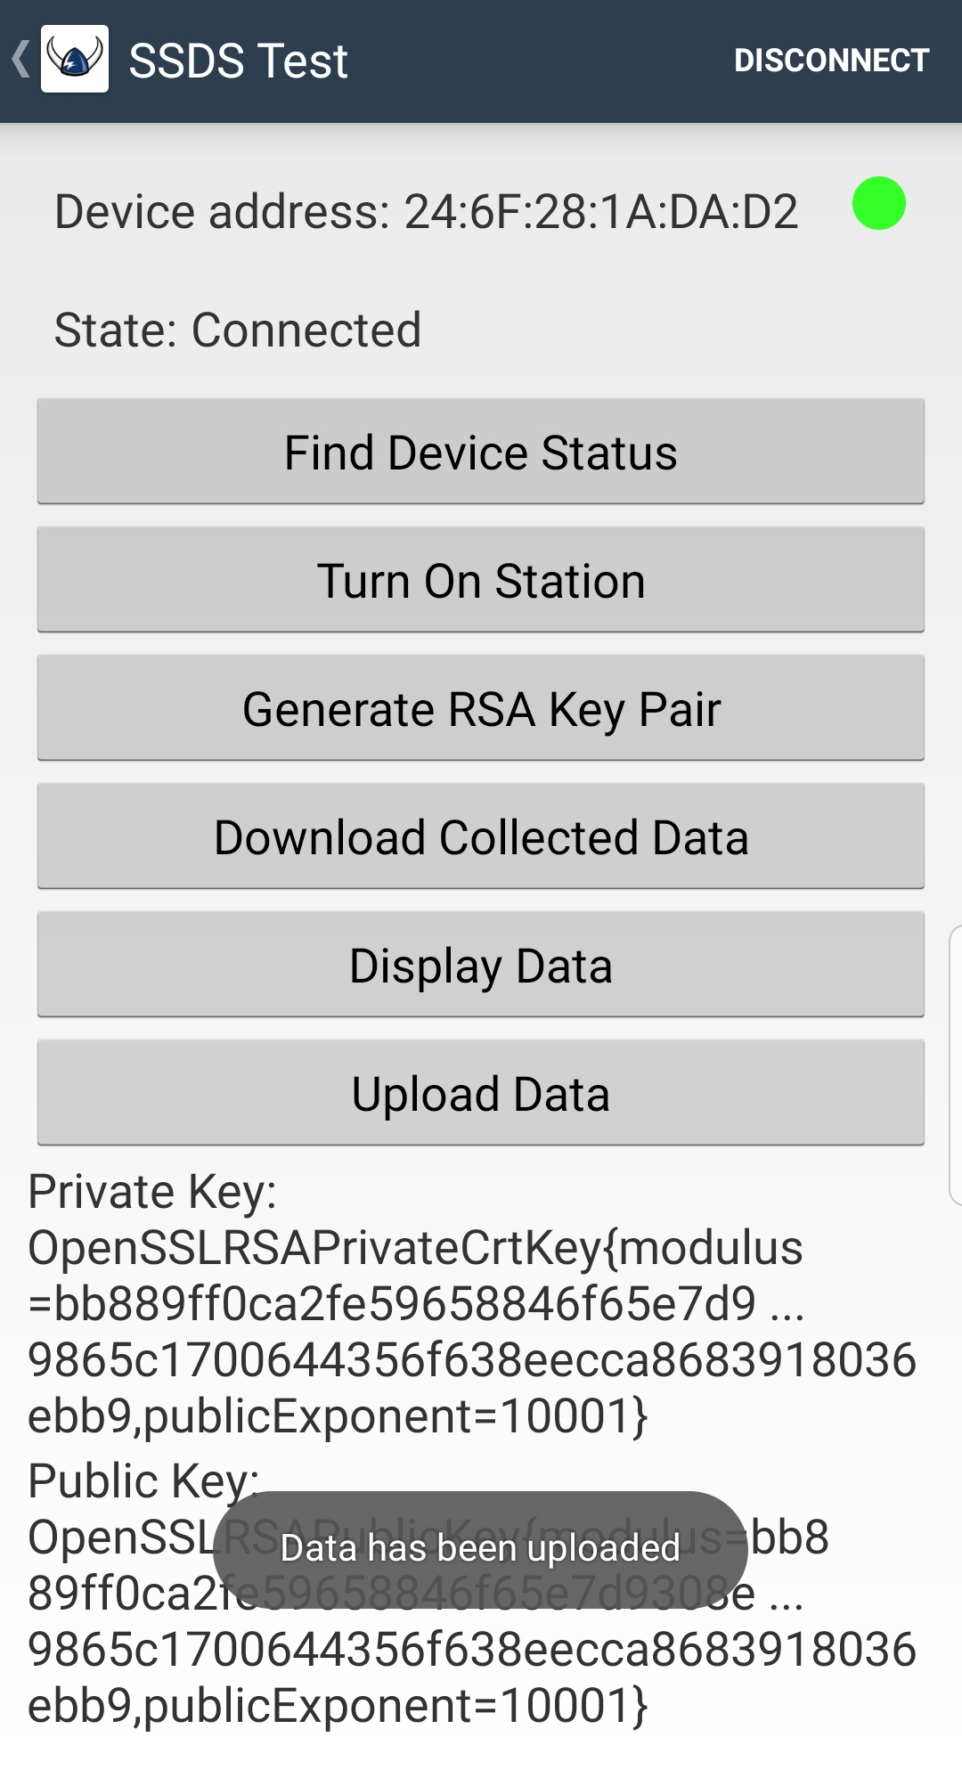
Android Phone App

Slide 8

The Django Web Framework
It big
It bulky
It got it's opinions

Slide 9
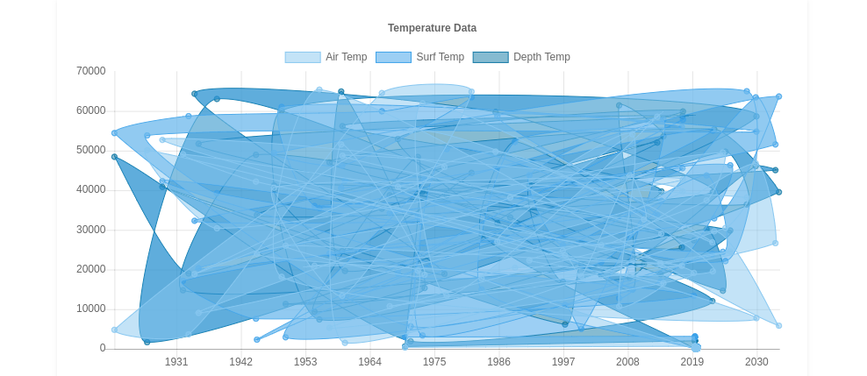
Data Visualization

Slide 10

PostgreSQL
Django provides support for a number of database systems
SQLite
MySQL
PostgreSQL
Our implementation uses PostgreSQL
Highly extensible
Object-relational database, provides features such as table inheritance (useful for multiple types of data)
Includes built-in support for hash-based indexing
Speed up data retrieval
Worth noting that the feature set is similar to most other database systems
It's a relational database, yo

Slide 11
Difficulties
We inherited a large codebase. This comes with its own issues:
Lack of documentation
Disorganized repositories for each component
Steep learning curve
Electrical engineering
Technologies used were already chosen for us
NOTHING HAS CHANGED

Slide 12
Where we started
Limited understanding of technical details
Mostly working state
All components were functional but missing key features
Unclear what needed to be finished or redone completely
Next to no documentation
Made testing difficult and understanding the overall system almost impossible
Scattered code base
OOF, NOTHING HAS CHANGED

Slide 13
Where we are now
All of the components are up and running for testing and validation
Prototype data station put together
Web app and database currently online
Increased understanding of technical details
Documented the majority of the project
Cleaned up code base
Slight improvements for user experience

Slide 14
Thanks to...
Previous teams, for their work and continued support
Dr. Erik Fretheim, for leading the project, providing hardware, and being patient :)
Dr. Aran Clauson and Dr. Filip Jagodzinski
WWU Cyber Range
SEA Discovery Center

